Slide 1

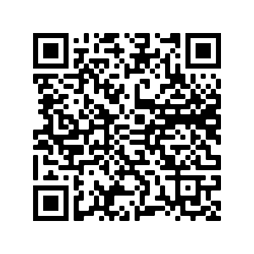
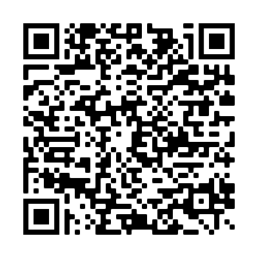


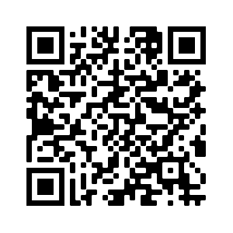

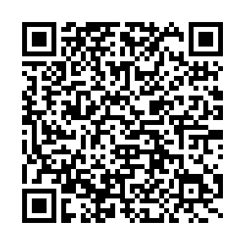
Welcome to MATH and SCIENCE with Mr. Snipes
Contact Information
Mr. Brian Snipes
(p) 336-605-3333
(e) snipesb@gcsnc.com
7th Grade Math and Science Information
7TH Grade Parent Information Form
Join Remind101 (for parents and students):
ACC MATH: Text @accma24 to the number 81010 OR go to https://www.remind.com/join/accma24
SCIENCE: Text @7thsci24 to the number 81010 OR go to https://www.remind.com/join/snipessci
Expectations:
Come to class each day with a positive attitude
Login to Canvas each day
Participate in class daily
Complete all assigned work to the best of your ability
Be respectful to both your peers and teachers
Contact your teacher if you have questions
Amazon Science Class Wish List QR Code
TPT Science Class Wish List QR Code

